Slide 1
MAid app
The
A full-stack Medical Tool
for Nurses and Healthcare Providers

Slide 2
Introduction
Purpose: A reference app for medical professionals to:
Look up medications, their dosages, their alternative names
Look up illicit drugs and their alternative names
Quickly and efficiently calculate patient BMI (Body Mass Index)
Key Features:
Searchable Database, PDF Export, user authentication

Slide 3
Tech Stack
Frontend:
HTML5, CSS3, Bootstrap 5
JavaScript, Font Awesome
Backend:
Node.js, Express.js
MySQL via MySQL2
Authentication: bcrypt + express-session
Tools:
VSCode, MySQL Workbench, Adobe Illustrator (logo)

Slide 4
Project Directory Structure:
maid-app/
├── assets/
├── js/
├── css/
└── images/
├── index.html
├── medications.html
├── drugs.html
├── bmi.html
maid-api/
├── routes/
├── db/
└── server.js

Slide 5
System Architecture
Diagram:
Client browser → Frontend (HTML/CSS/JS) → API (Express) → MySQL DB
API Endpoints
/api/users
/api/medications
/api/drugs
Authenticated sessions with express-session

Slide 6
Database Schema
Users Table:
Id, username, password_hash
Medications Table:
med_id, name, generic_name, dosage
Illicit Drugs Table:
drug_id, name, description

Slide 7
Flowchart – User Interaction
User
Login Page
API Auth
Session Created
Redirect to Dashboard
User
Select BMI / Meds / Drugs
Fetch from API
Render on Page

Slide 8
Feature Highlights
BMI Calculator using US Imperial Units
Alphabetized medication and drug directories
Export any section as a printable PDF
Responsive UI for desktop view

Slide 9
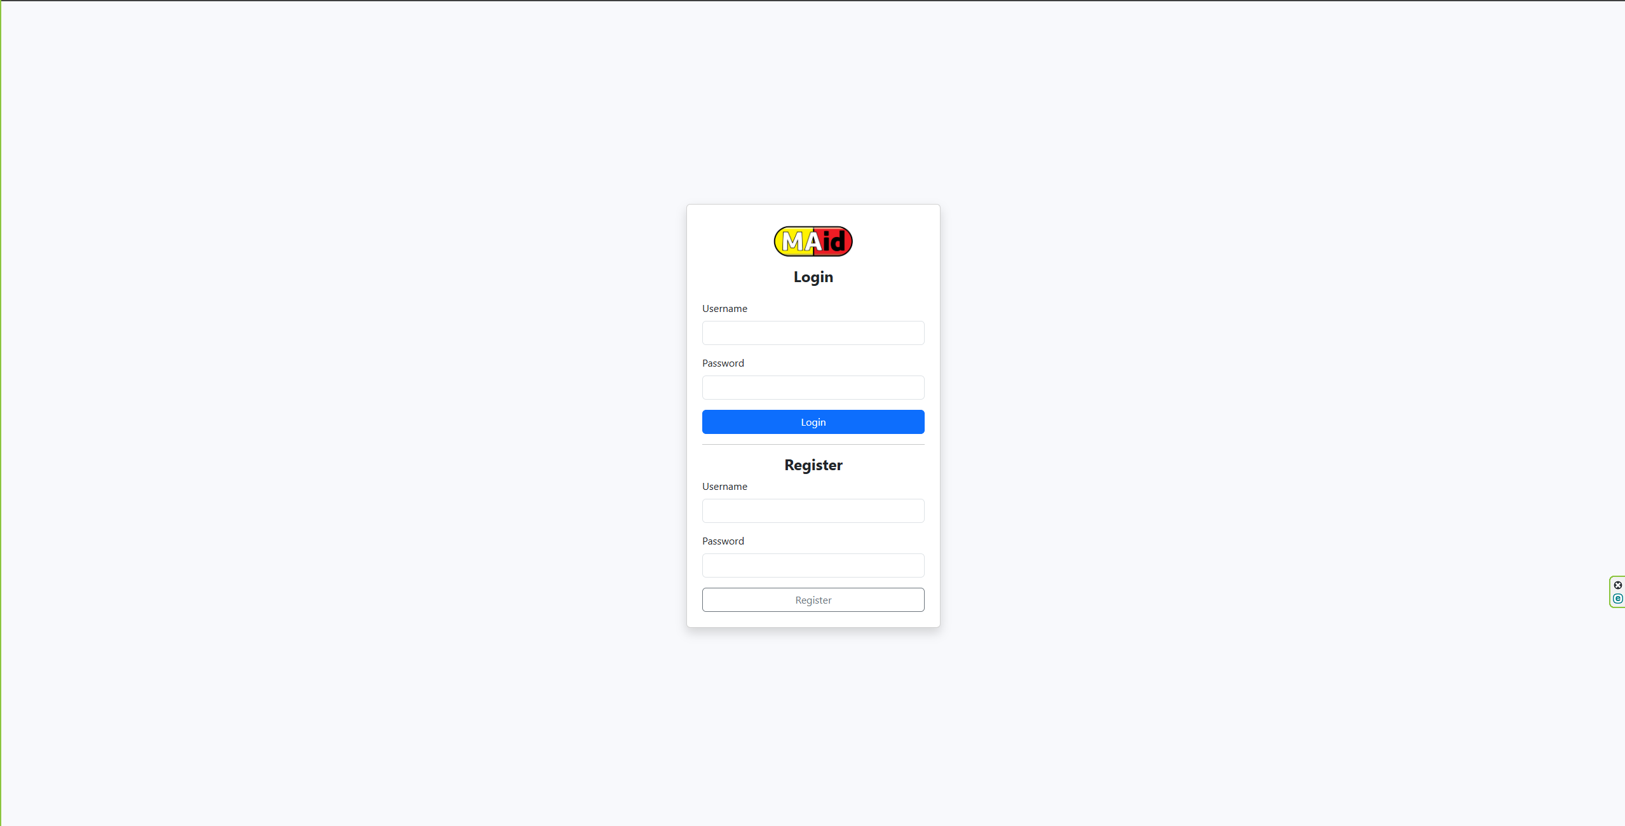
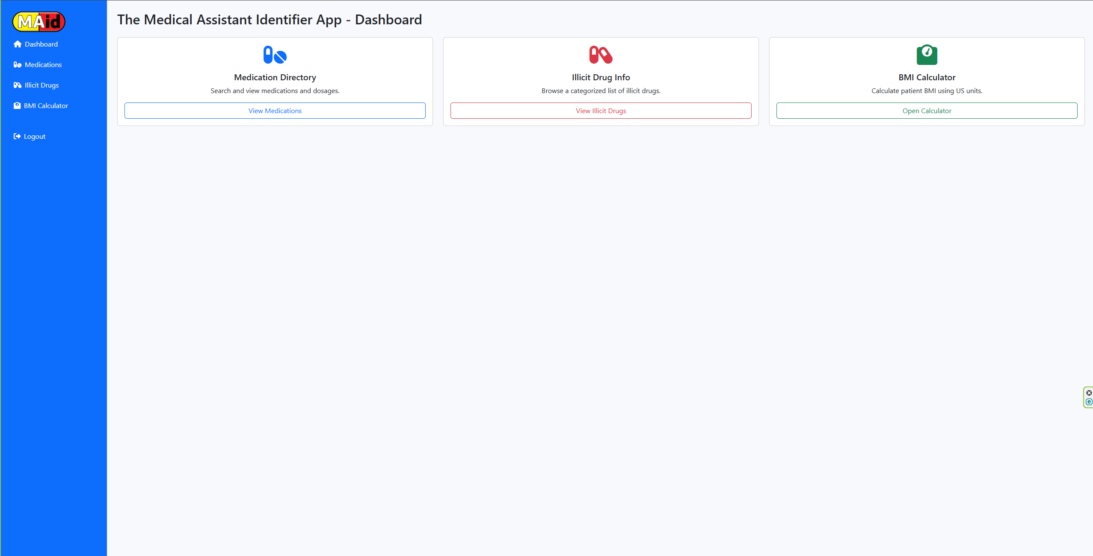
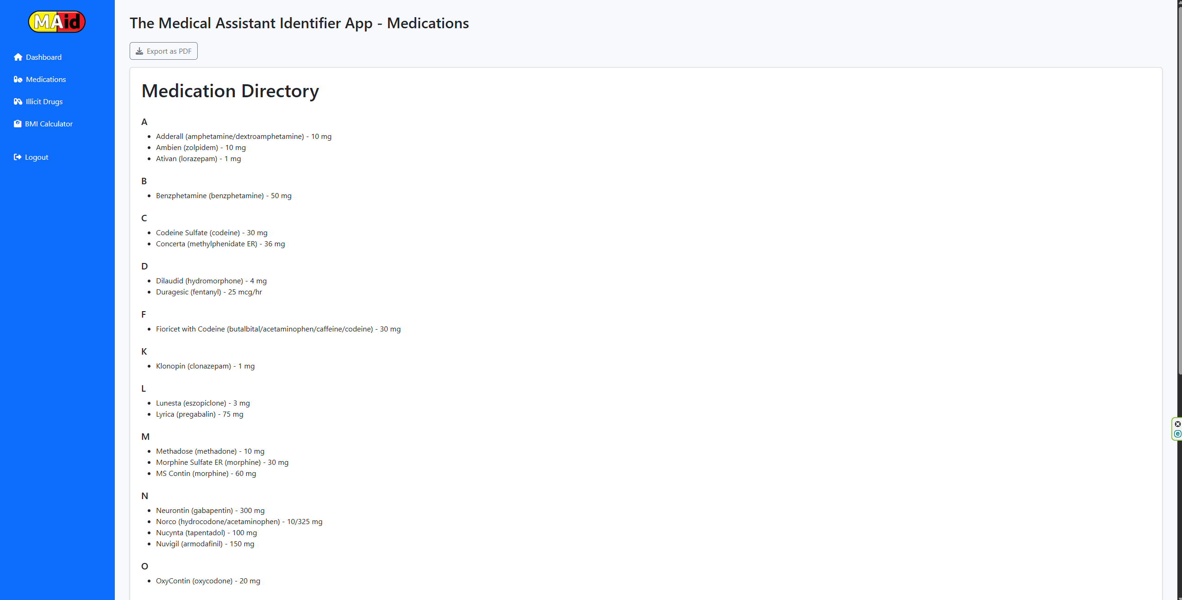
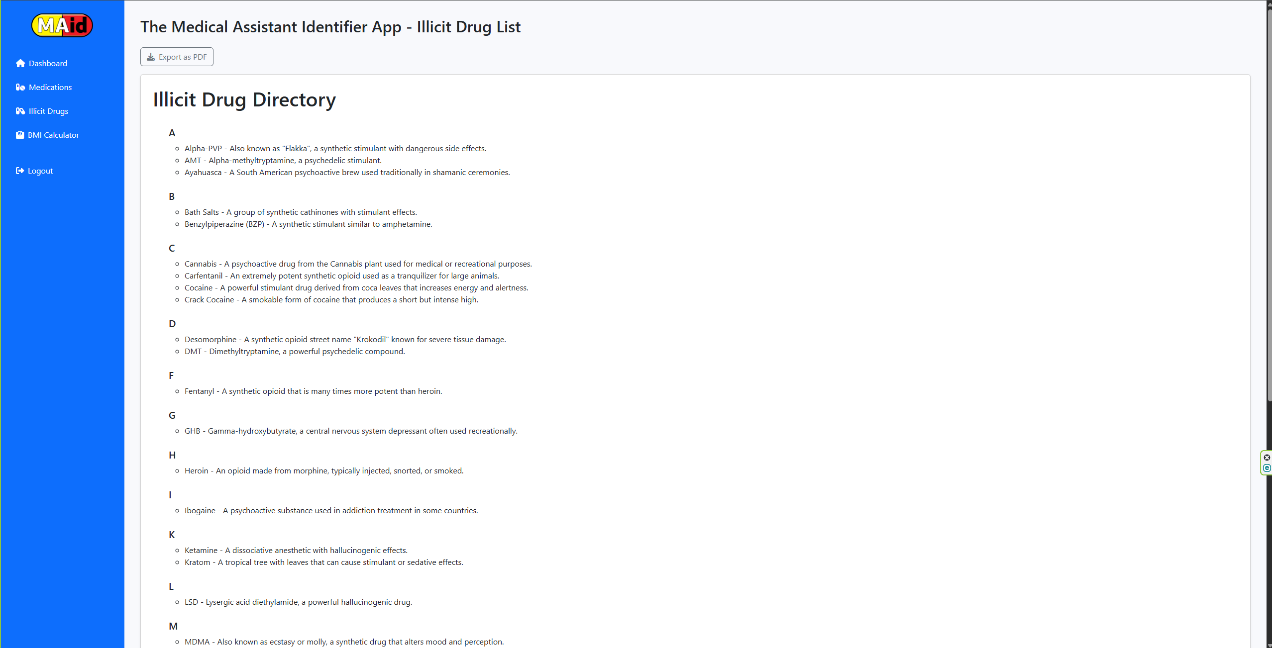
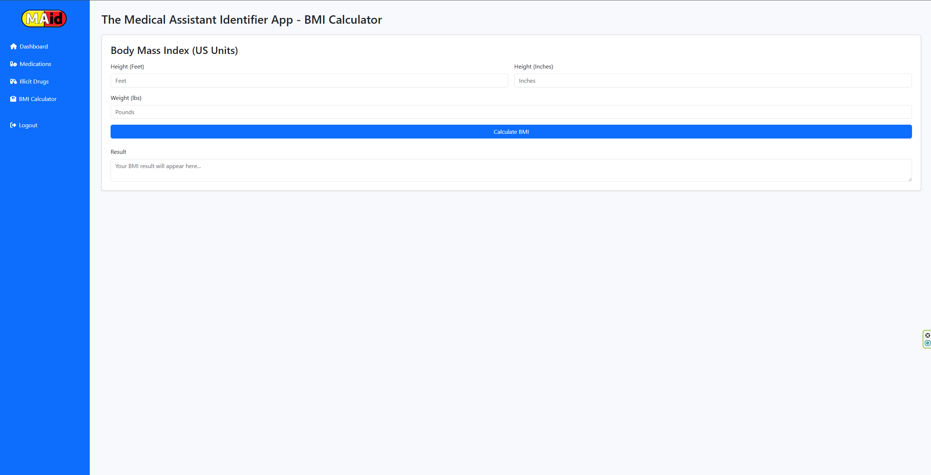
UI Previews

Slide 10
Challenges & Lessons
Managing form validation and error feedback
SQL errors from duplication
Integrating PDF export from DOM
Maintaining clean structure between API + UI

Slide 11
Conclusion
Built for efficiency and clarity in medical reference
Great for solo developers seeking full-stack project experience
Future improvements: Mobile view, search bar, dark mode

Slide 12
Thank You!
GitHub Repo: https://github.com/Marqm713/MAid-App
Designed and Built by Marques McGaughy

